Slide 1
Air Barrier Systems –
Understanding the Technologies and their Importance
AIA Course # MMMAB101

Slide 2






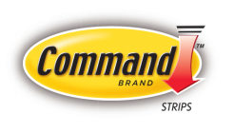

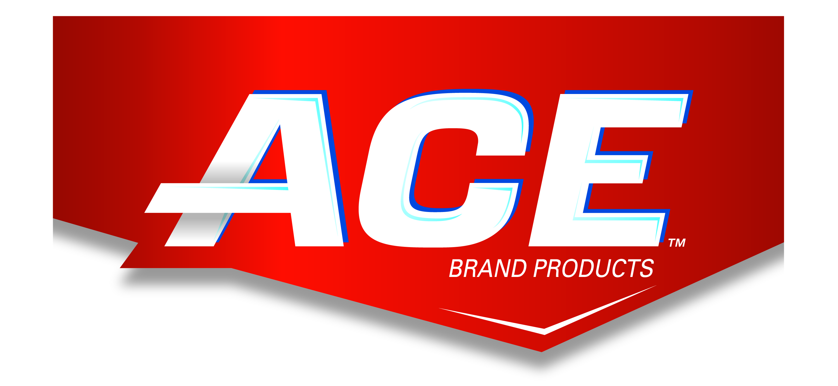


A consumer is no more than 5 five feet from a 3M product…
$29.6 Billion in sales in over 200 countries
R&D investment of $1.6 Billion per year
Launched more than 1200 new products in 2010
One of 50 most admired companies in the world
© 3M 2016. All Rights Reserved.
Notes:
The 3M brand is one of the most trusted around the world. We’ve consistently been acknowledged for the leadership, and quality that our brand conveys.
The promise of this quality and innovation at 3M is one that is delivered through other brands we have created to underline our capabilities in key product categories where we have built substantial and diverse product portfolios.
You may recognize some of them here…..we call these our strategic brands, and we continue to invest and support these brands and the associated products they bring to the marketplace. They are key proof points of our innovation and capability to enable success and connect with our customers.

Slide 3

AIA Best Practices
3M is a Registered Provider with the American Institute of Architects Continuing Education Systems. Credit earned on completion of this learning unit will be reported to CES records for AIA members. Certificates of Completion for non-AIA members are available upon request.
This program is registered with the AIA/CES for continuing professional education. As such, it does not include content that may be deemed or construed to be an approval or endorsement of the AIA of any materials of construction or any method or manner of handling, using, distributing, or dealing in any material or products. Questions related to content within this online learning unit can be directed to 3M upon completion.

Slide 4
Course Description
This course is intended to give an overview of an aspect of Sustainable Design (SD): Air Barriers. Air barriers meet this criterion because they support the definition of sustainable design through energy efficiency, building longevity, and improvement in air quality. The focus of this presentation is on COTE Measure #7: Energy Flows and Energy Future. This presentation meets the Health, Safety, Welfare (HSW) guidelines specifically around Health and Safety. It focuses on the HSW topic of Weatherproofing and Insulation. Greater than 75% of this course will focus on these topics.
This course will provide an overview of air barrier construction in commercial buildings and offer insights into the benefits of air barriers. Design considerations will be presented both around specification and installation. The importance of substrate preparation is shown in order to achieve desired air barrier performance.
Different materials and application methods are covered, including benefits and considerations. Application errors are shown for field verification and correction before building completion. Finally, test methods to verify air barrier performance are shown. Typical warrantees are described to ensure air barrier effectiveness.
Notes:
This course will give provide an overview of roof construction common in commercial buildings, and offer a specific examination of multi-layer roof applications typical of flat-roof construction. Because flat roof construction has unique challenges and durability issues associated with water, selecting an adhesive system that will complement the roof structure is important. This learning unit will also explore productivity and material costs issues related to flat roof construction.
Finally, this course will offer the student an opportunity to learn how to successfully choose the most appropriate adhesive for flat roof construction by comparing and contrasting different types and styles offered by manufacturers today. Although many adhesives may seem similar, each brand and type has a specific set of attributes related to durability, strength, healthfulness, cost, and ease of use that can greatly impact the performance of the roofing system. Properly selecting the best adhesive based on these attributes is a critical part of the material selection, productivity, and quality assurance aspect of the construction project.

Slide 5
Learning Objectives
Benefits of Air Barriers in commercial construction
Design considerations when selecting an air barrier
  How to avoid moisture related problems
Application methods: peel & stick vs. spray
  Avoiding common application issues
ASTM tests to meet standards

